Slide 1

Early Detection of Diabetes Using Machine Learning
Group 10
LiuLiu、BianBingzhi、FangXiao、SunPenglin、XieHaoHua
2025.4.9
PowerPoint Design

Slide 2
CONTENTS
Project Background and Significance
Current Technologies and Challenges
Dataset Description and Characteristics
01
02
03
Data Processing and Feature Engineering
Model Selection and Training
Model Evaluation
04
05
06
Model Results and Analysis
Front-End Implementation
Conclusion and Future Work
07
08
09

Slide 3
c
c
01
PART
Project Background and Significance

Slide 4
Global Impact of Diabetes
Importance of Early Detection
Diabetes as a Chronic Metabolic Disorder
Early detection is critical for preventing severe complications such as retinopathy and cardiovascular diseases. Traditional diagnostic methods like OGTT are reliable but costly and complex for large- scale screening. The Pima Indians Diabetes Dataset is a benchmark for machine learning research in this domain, providing valuable data for predictive modeling.
Diabetes affects over 500 million people globally, causing severe complications like cardiovascular diseases and kidney failure. It is a leading cause of morbidity and mortality. The economic burden is substantial, with billions spent annually on healthcare costs, medication, and managing complications. Indirect costs due to loss of productivity further exacerbate its impact.

Slide 5

Project Purpose
Development of a Predictive Model
The project aims to develop a machine learning- based diabetes prediction model using the Pima Indians Diabetes dataset. The dataset contains health indicators significantly correlated with diabetes occurrence. The goal is to accurately predict the probability of an individual developing diabetes through in- depth analysis and modeling of the data.
User-Friendly Interface
A user- friendly front- end interface is constructed to simplify the user input process. Users can easily enter personal health data and obtain diabetes risk assessment results. This aims to increase public awareness of early diabetes screening and provide strong support for related health management.

Slide 6
c
c
02
PART
Current Technologies and Challenges

Slide 7


Feature Engineering Methods
Interactive and Automated Feature Construction
Existing technologies support interactive feature construction and automated feature generation. SHAP value analysis combined with RFE reduces redundant features in the data for analysis. These methods enhance the quality and relevance of features used in predictive modeling.
Predictive Modeling Techniques
Ensemble learning frameworks, such as stacking methods combining XGBoost and LightGBM, achieve high performance with some combinations reaching a 92% AUC. Graph neural networks are employed to address relational data within Electronic Health Records (EHR), improving the understanding of patient relationships and outcomes.

Slide 8

Technological Bottlenecks
01
02
Missing Value Treatment
Model Interpretability and Generalization
The treatment of missing values often relies on simple statistical methods like the global median, which do not fully leverage feature correlations. Only 23% of features with a Pearson correlation greater than 0.4 are utilized. More sophisticated methods are needed to handle missing values effectively and improve model accuracy.
Balancing model interpretability and performance is a significant challenge. The cost of interpreting ensemble models is 5- 7 times higher than that of logistic regression. Ensuring cross- population generalization is difficult, as models may not perform well on diverse datasets.

Slide 9
c
c
03
PART
Dataset Description and Characteristics

Slide 10

Source of the Dataset
Pima Indians Diabetes Database
The dataset used is the Pima Indians Diabetes Database, obtained from the National Institute of Diabetes and Digestive and Kidney Diseases and published on Kaggle. It contains medical diagnostic data from female patients of Pima Indian heritage, aiming to predict the onset of diabetes within five years based on diagnostic measurements. The dataset includes 768 instances with 8 numerical medical predictors and 1 binary class variable (diabetes diagnosis).
Key Dataset Details
The dataset features include Pregnancies, BloodPressure, SkinThickness, Insulin, BMI, DiabetesPedigreeFunction, Age, and Outcome. All patients are females of at least 21 years old, from the Pima Indian heritage group. The dataset is widely used for binary classification tasks in machine learning.

Slide 11
Dataset Characteristics
STEP. 01
STEP. 02
Feature Details
Data Quality Issues
Pregnancies: Number of pregnancies (integer, range 0- 17). BloodPressure: Blood pressure reading (float, range 0- 199 mmHg). SkinThickness: Thickness of skin (float, range 0- 99 mm). Insulin: Insulin level (float, range 0- 846 μU/mL). BMI: Body Mass Index (float, range 0.0- 67.1). DiabetesPedigreeFunction: Function indicating diabetes heritage (float, range 0.078- 2.420). Age: Age of the individual (integer, range 21- 81). Outcome: Diabetes outcome (binary, 0 = No, 1 = Yes).
The dataset contains inherent quality issues such as missing values and zero values in critical features like Glucose, BloodPressure, SkinThickness, Insulin, and BMI. Addressing these issues through data cleaning and imputation is essential for accurate predictive modeling.

Slide 12
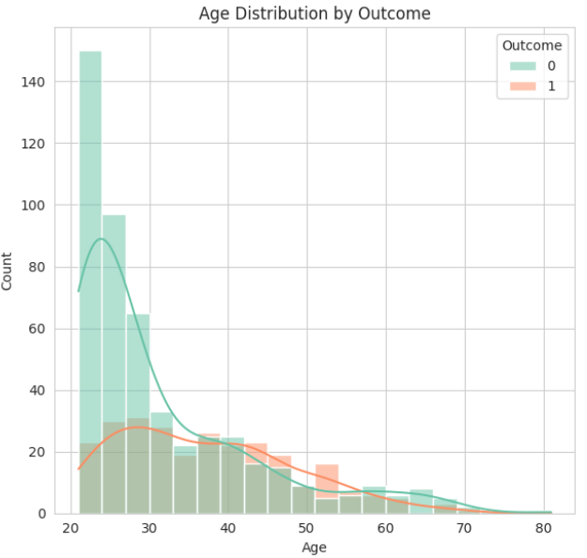
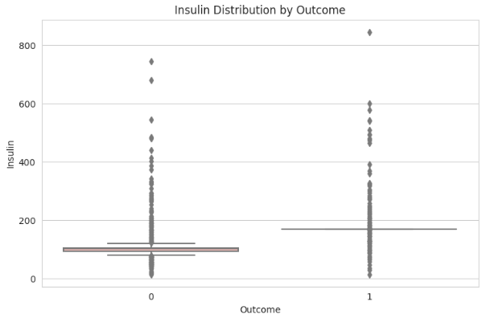
Some visualization

Slide 13
c
c
04
PART
Data Processing and Feature Engineering

Slide 14
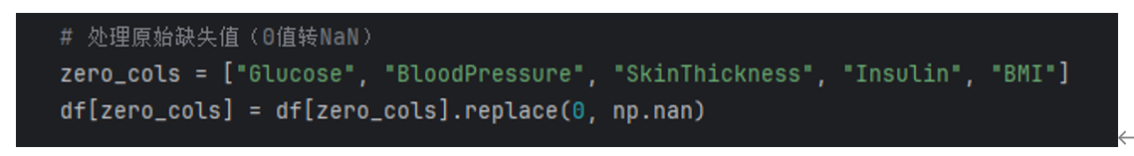
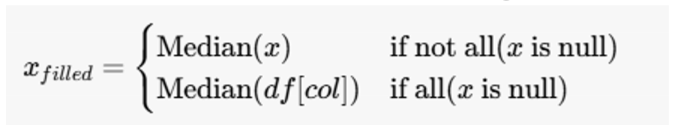
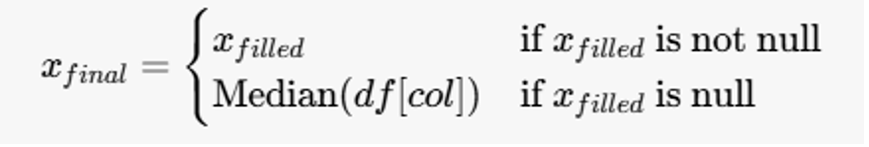
Data Cleaning
Invalid Zero Value Identification
Target features: Glucose, BloodPressure, SkinThickness, Insulin, BMI. Zero values in these metrics are physiologically impossible (e.g., fasting glucose < 70 mg/dL indicates hypoglycemia). Identifying and handling these invalid zero values ensures data accuracy and reliability.
Stratified Imputation
The data is grouped according to the Outcome column. For missing values in each group, the median of the group is used to fill them. If all values in the group are missing, the median of the entire column is used. This approach preserves the distribution of the data and improves imputation accuracy.
Fallback Global Imputation
Ensures a complete dataset by using global imputation techniques as a fallback when other methods fail. This step is crucial for handling missing values and maintaining data integrity for model training.

Slide 15

Feature Engineering
New Feature Creation
New features added to the dataset include Glucose_BMI (product of blood glucose concentration and BMI), Age_Insulin (product of age and insulin level), BMI_Age (product of BMI and age), Glucose_Insulin_Ratio (ratio of blood glucose concentration to insulin level), and Gender (derived from the number of pregnancies). These new features enhance the model's ability to capture complex relationships and improve predictive performance.
Data Standardization and Imbalance Treatment
Data standardization adjusts feature values to the same scale (mean 0 and standard deviation 1) using the StandardScaler function. This is essential for distance- based algorithms. Imbalance treatment using SMOTE generates synthetic samples to balance the number of positive and negative samples, improving model performance on minority classes.

Slide 16
c
c
05
PART
Model Selection and Training

Slide 17
Model Introduction
01
02
03
Random Forest
XGBoost
LightGBM
Random Forest is a parallel integrated learning framework based on Bagging. The algorithm uses Gini Impurity as the splitting criterion, effectively reducing model variance and improving prediction accuracy.
XGBoost is an innovative implementation of the Boosting framework based on Gradient Boosting Decision Tree. The algorithm uses a regularized loss function and a sparsity- aware Split Finding algorithm, which improves AUC and handles missing values efficiently.
LightGBM is a gradient boosting framework based on histogram optimization. The algorithm is highly efficient and scalable, making it suitable for large datasets and complex predictive tasks.

Slide 18
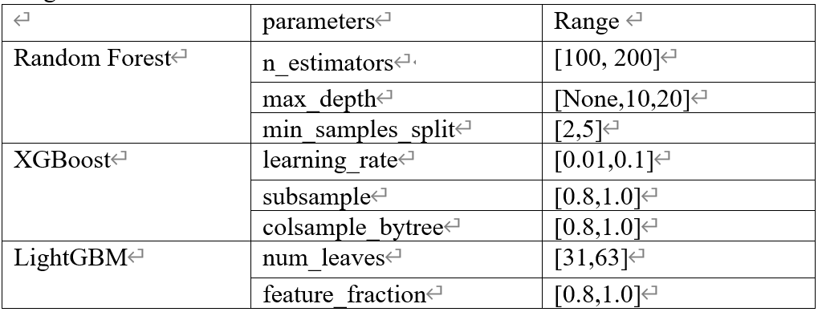
Hyperparameter Tuning
Grid Search Framework
Parameter Space Design
A systematic grid search framework is used for hyperparameter optimization. Stratified 5- fold cross- validation ensures balanced sampling and reproducibility. The evaluation metrics used are ROC and AUC, which provide a comprehensive assessment of model performance.
For Random Forest, the core tuning parameters include n_estimators (100, 200), max_depth (None, 10, 20), and min_samples_split (2, 5). For XGBoost, the parameters are learning_rate (0.01, 0.1), subsample (0.8, 1.0), and colsample_bytree (0.8, 1.0). For LightGBM, the parameters are num_leaves (31, 63) and feature_fraction (0.8, 1.0). Each model evaluates 12 combinations.

Slide 19
c
c
06
PART
Model Evaluation

Slide 20
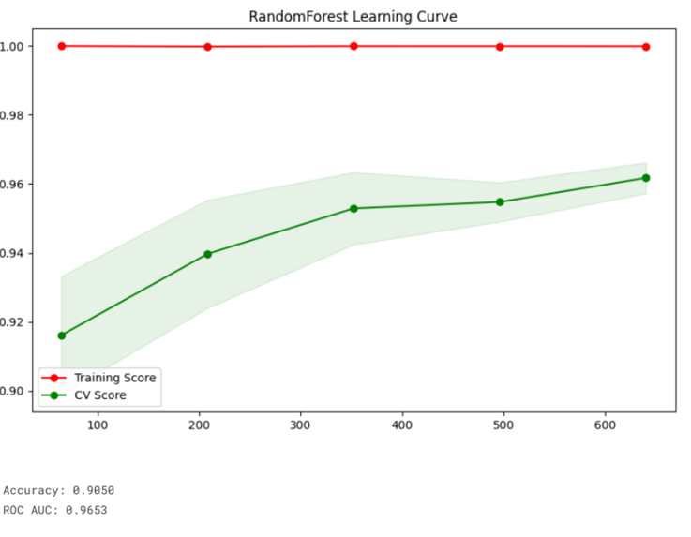
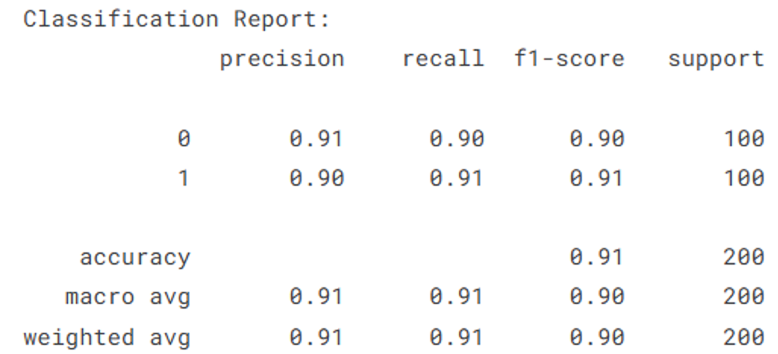
Single-Model Performance
Random Forest Performance
Classification Report
A classification report is generated to evaluate the model's performance in terms of precision, recall, and F1- score. This provides a detailed understanding of how well the model is performing on different classes.
The Random Forest model shows high training scores, indicating potential overfitting. However, cross- validation scores improve with more training samples, demonstrating some generalization ability. The model's accuracy and ROC AUC score are evaluated to assess its predictive performance.

Slide 21

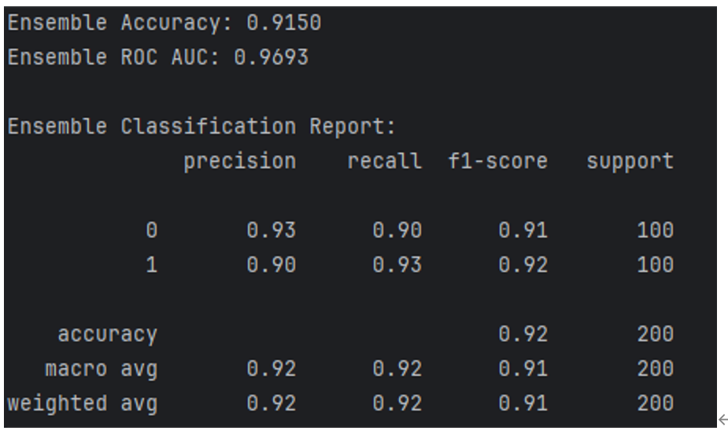
Ensemble Learning Model
The Soft Voting ensemble learning model combines the predictions of Random Forest, XGBoost, and LightGBM using weighted averaging. This approach leverages the strengths of each model, reducing bias and variance to achieve better predictive performance.
The ensemble learning model outperforms the Random Forest model, demonstrating the effectiveness of combining multiple models. The model's ability to capture complex relationships and improve accuracy is validated through performance metrics.
Soft Voting Mechanism
Performance Comparison

Slide 22
c
c
07
PART
Model Results and Analysis

Slide 23
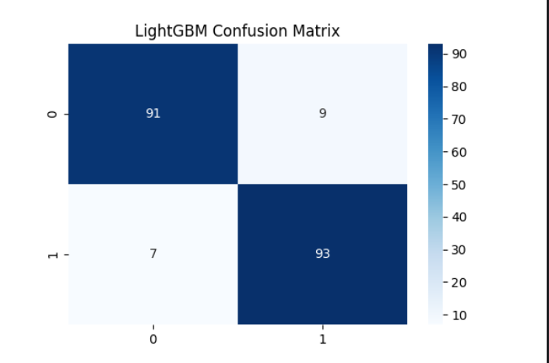
Best Model Selection
Model Comparison
Reasons for LightGBM's Superiority
The best- performing model is selected based on the ROC AUC score. LightGBM emerges as the top model, achieving a 94.3% AUC. The ensemble learning model also performs well, achieving a 0.963 ROC AUC, outperforming individual models by 2.1- 4.3%.
LightGBM's extensive hyperparameter tuning options allow for optimal performance through methods like grid search. The model's efficiency and scalability make it a strong choice for complex predictive tasks, outperforming the ensemble learning model in this case.

Slide 24
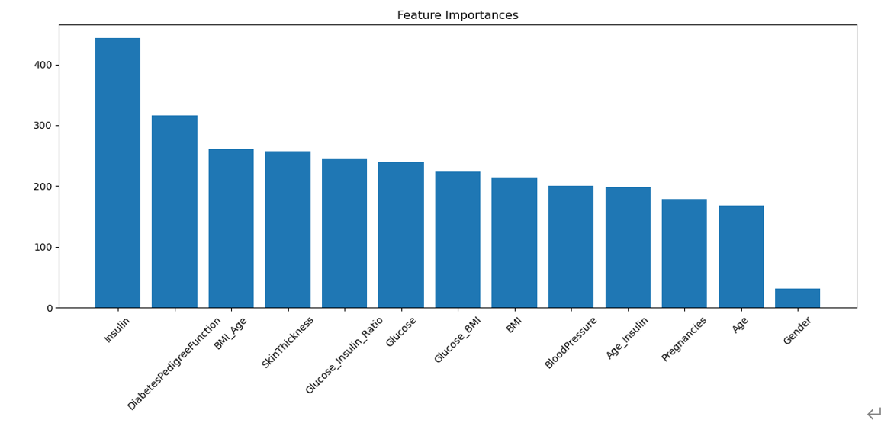
Feature Importance Analysis
01
02
Identifying Key Features
Implications for Model Optimization
Focusing on important features like Insulin and Diabetes Pedigree Function can enhance model performance. Removing low- importance features can simplify the model, improve interpretability, and reduce computational cost.
Feature importance analysis reveals that Insulin is the most influential feature, followed by Diabetes Pedigree Function and Age. Other features like BMI, Glucose, and Pregnancies have relatively lower importance but still contribute to the model's predictions.

Slide 25
c
c
08
PART
Front-End Implementation

Slide 26
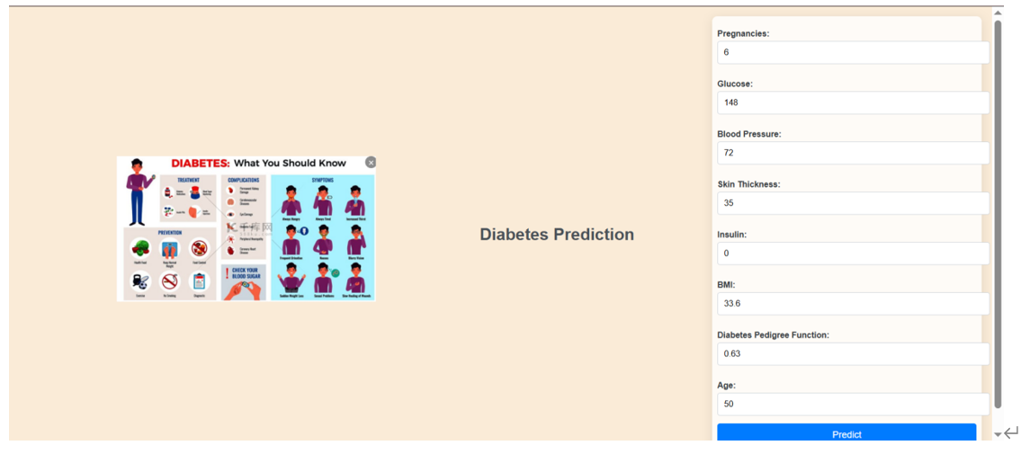
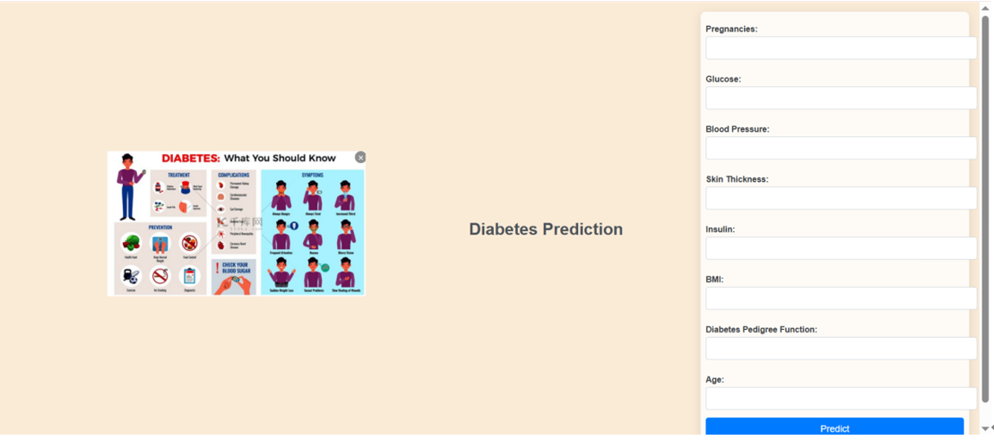
User Input Interface
02
01
Real-Time Prediction
User-Friendly Design
The project features a user- friendly UI interface where users can input their health data, including Pregnancies, Glucose, Blood Pressure, Skin Thickness, Insulin, BMI, Diabetes Pedigree Function, and Age. The interface calculates derived features like Gender, Glucose_BMI, Age_Insulin, BMI_Age, and Glucose_Insulin_Ratio to improve prediction accuracy.
After entering the data, users can click the prediction button to obtain real- time diabetes risk assessment results. The system sets a high probability threshold of 50% to determine the likelihood of diabetes.

Slide 27
c
c
09
PART
Conclusion and Future Work

Slide 28



Key Contributions
Data Quality Enhancement
The project's hierarchical imputation strategy effectively addresses missing values, improving data quality and model accuracy. Innovative composite features like Glucose_BMI and Age_Insulin enhance model interpretability and capture nonlinear metabolic interactions.
Algorithmic Advancements
The optimized ensemble model achieves significant performance improvements, with LightGBM emerging as the most efficient single model. Hyperparameter tuning through grid search reduces cross- population generalization gaps, enhancing model robustness.

Slide 29
Limitations and Future Directions
Demographic Bias
01
The reliance on Pima Indian female data limits the model's generalizability. Future work should incorporate multi- ethnic cohorts to improve model applicability.
Interpretability-Performance Trade-off
02
While SHAP values provide partial explanations, advanced techniques like counterfactual analysis could enhance clinical trust and model interpretability.
03
Temporal Dynamics
Integrating longitudinal health records may improve prediction accuracy for progressive conditions like diabetes, providing a more comprehensive understanding of disease progression.

Slide 30
Transformative Potential
01
02
This research underscores the transformative potential of machine learning in public health screening. The framework offers a scalable solution for diabetes prevention and personalized health management.
By bridging technical rigor with clinical needs, the project demonstrates the potential for machine learning to revolutionize early disease detection and management.

Slide 31
谢谢大家
Group 10
LiuLiu、BianBingzhi、FangXiao、SunPenglin、XieHaoHua
2025.4.9

